Slide 1
foodBIT
Project definition
IT-632 Software Engineering Msc(IT) 2020-21
Members:
202012007 Pranay Joshi
202012036 Meghani Harsh Rajnishbhai
202012053 Asnani Chandni Nareshkumar
202012094 Himanshu Joshi (Team Leader)
202012109 Patel Vishal Natvarbhai
By Team : 05

Slide 2
foodBIT
IT-632 Software Engineering Msc(IT) 2020-21
Lack of Information
Unhealthy diet
Problem Statements
Fitness Freak

Slide 3
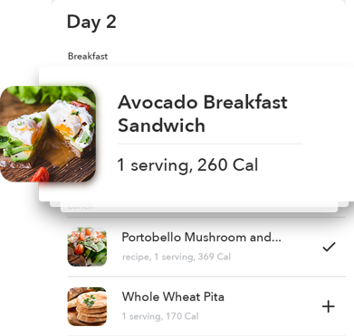
foodBIT
IT-632 Software Engineering Msc(IT) 2020-21
Solution :
This system would be able to estimate the caloric content of the plate of food based on an image.
It can also help to create a diet chart according to one’s physique.
It will also contain informative features such as identification of category of food, regional cuisine.

Slide 4
foodBIT
IT-632 Software Engineering Msc(IT) 2020-21
Functionality :
Food Identification:
The user will be able to upload an image of the food item. And then the software will display the name of the food item/dish present in the picture..
Food Information:
The software will be able to provide certain vital information about the food item.
The total calorie count macro and micronutrients of the food item will be displayed. And Category of the food will also be provided.
Diet for user:
The user will input some information, including weight, height, age, and gender then a diet plan will be generated curated for the user using a specific algorithm based on the input provided.
Users can customize the meals according to their preferences and will be notified through notifications on the meal timings.

Slide 5

foodBIT
IT-632 Software Engineering Msc(IT) 2020-21
Conclusion :
In a nutshell, this software can help people to gain a detailed information about the particular dish. People can maintain healthy diet. The user can access the notification if they wish to this will help them to remember their diet.

Slide 6
foodBIT
IT-632 Software Engineering Msc(IT) 2020-21
Thank you….

